Slide 1







Implementing
SQL
Presented by Endah Rakhmawati

Slide 2


Background
This involves the historical processing of information, focusing on output data. It is useful in business analysis, providing summarized and multidimensional data views using SQL.

Slide 3

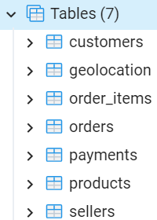
Dataset Overview
Dataset : https://bit.ly/4dRac7t
Target is a globally recognized brand and a leading retailer in the United States, known for offering exceptional value, inspiration, innovation.
This dataset focuses on Target's operations in Brazil, covering 100,000 orders placed between 2016 and 2018. It includes detailed information on order status, payment, seller and shipping performance, customer locations, product attributes.

Slide 4
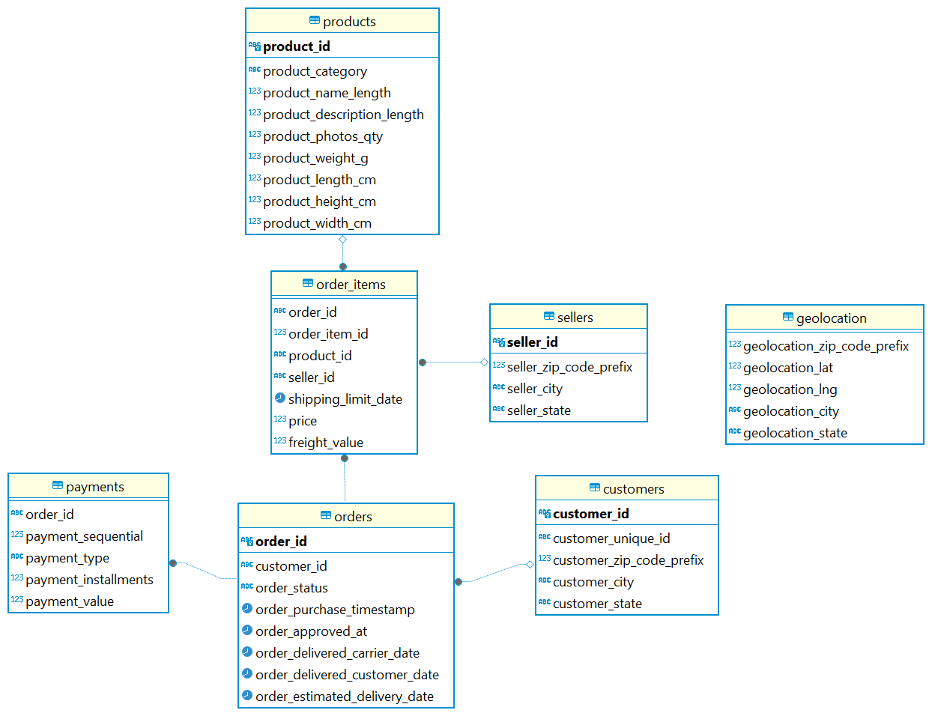
Database Diagram

Slide 5






Workflow
Load Tables
Data Cleaning
Creating database.
Designing tables.
Importing the values from csv files.
Generating the relationship diagram.
Remove duplicates.
Standarized the data.
Missing values handling.
Visualization
Querying
Creating db connection from postgresql into python.
Analyzing the questions with sql statements.
Get the result into dataframe
Making chart visualizations from the result.
Optional saving chart as image using plt.savefig()

Slide 6

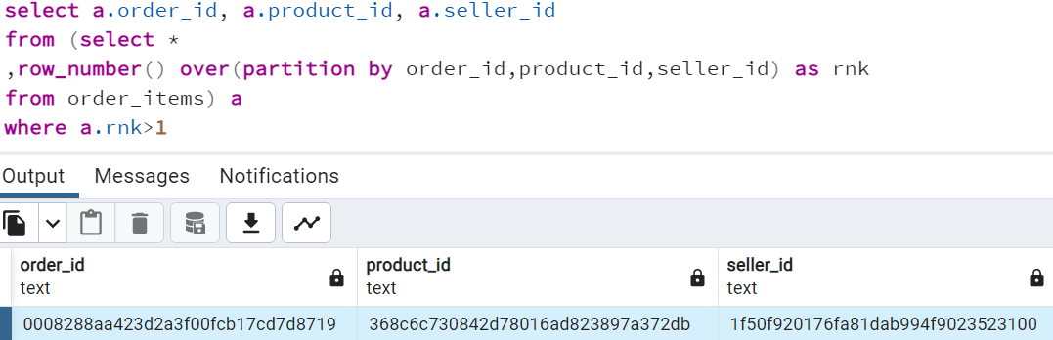
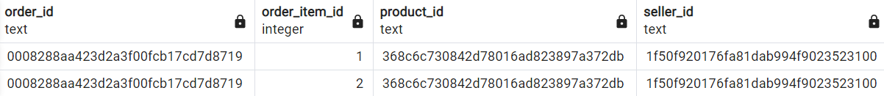
Remove duplicates
Based on my analyzing of the database, there aren't any duplicate rows foreach tables.
example:
In table order_items the quantity of items are stored by each order_item_id so it can't be deleted.

Slide 7
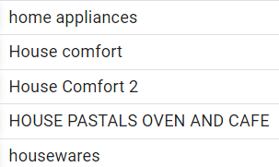
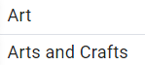
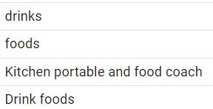
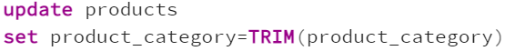
Standarized the data
examples:
we can update similar categories with one name. Based on my screening all the data type are correct. Don't forget to cut the spacing first.

Slide 8
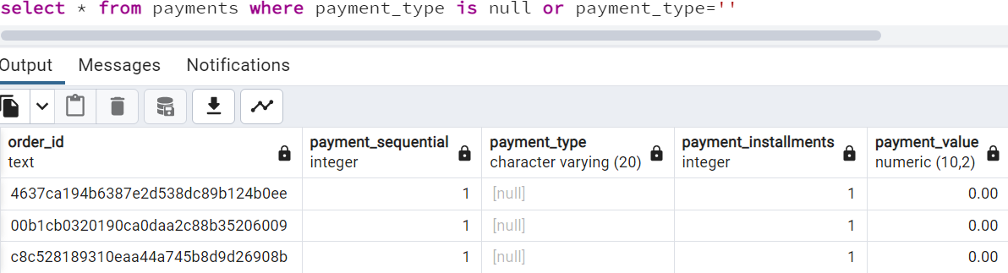
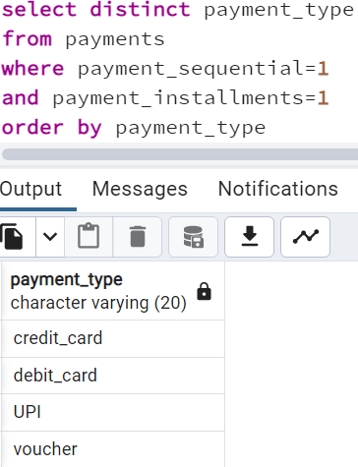
Missing value handling
After filtered by payment_sequential
and payment_installments, we can fill the null values with the available payment_type on the left side or fill with 'unidentified' because the payment_value is zero.

Slide 9
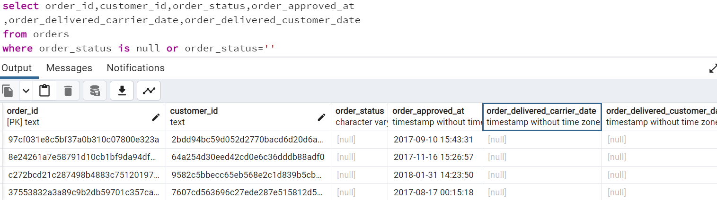
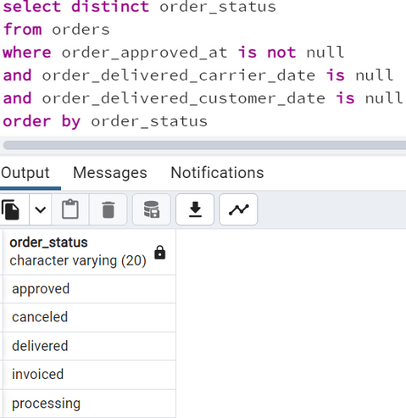
Missing value handling
After filtered by order_approved_at, order_delivered_carrier_date, order_delivered_customer_date, we can fill the null values with the available order_status on the left side

Slide 10
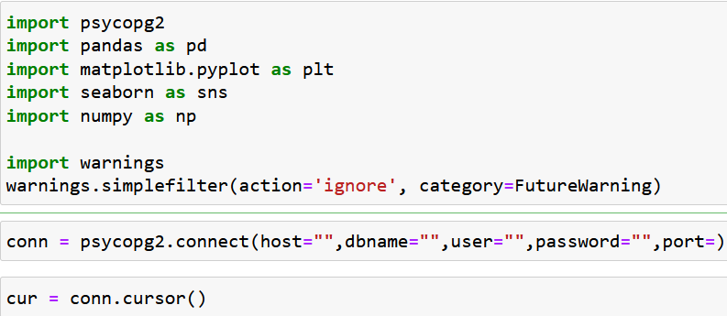
Connecting to database

Slide 11
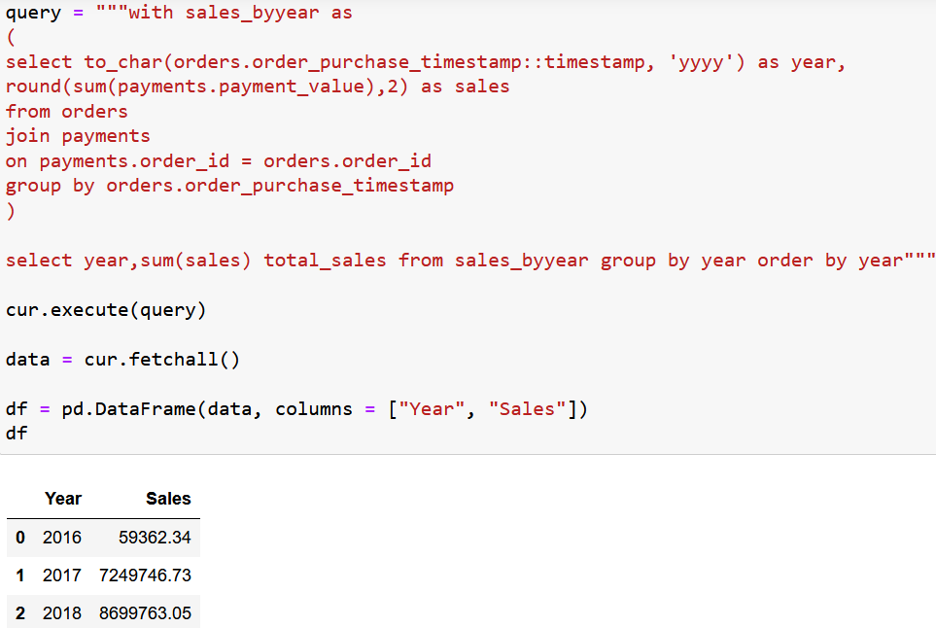
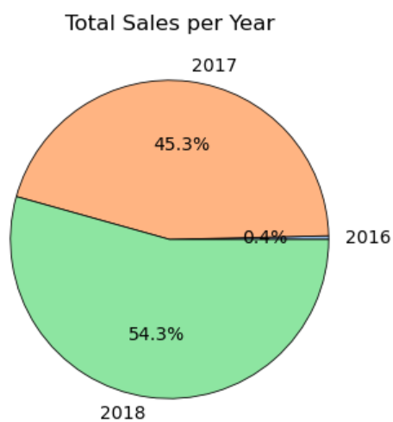
Question 1 : Find the total sales per year.

Slide 12
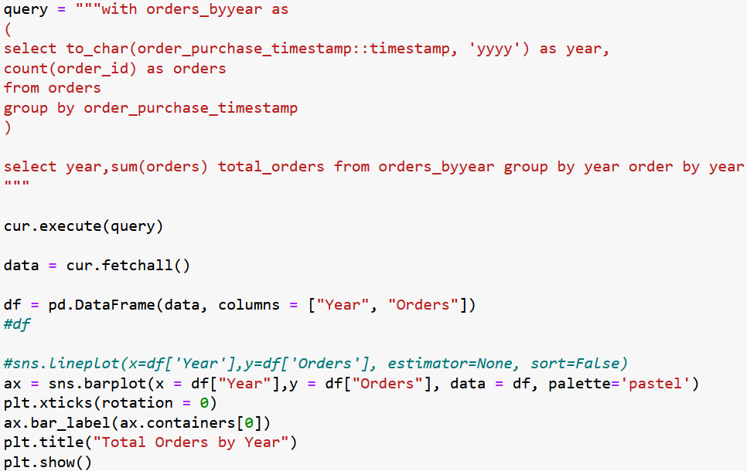
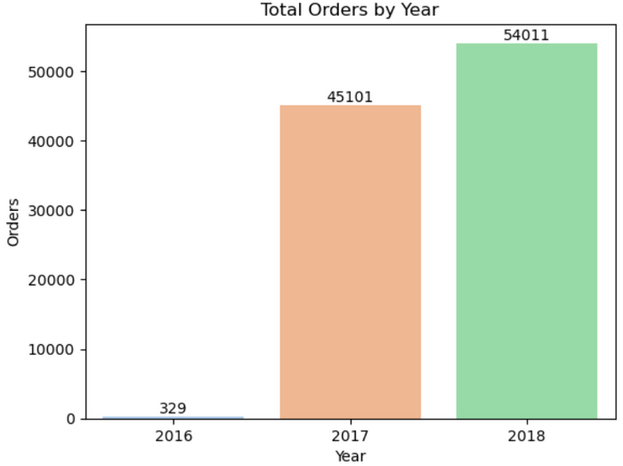
Question 2 : Count the number of orders per year.

Slide 13
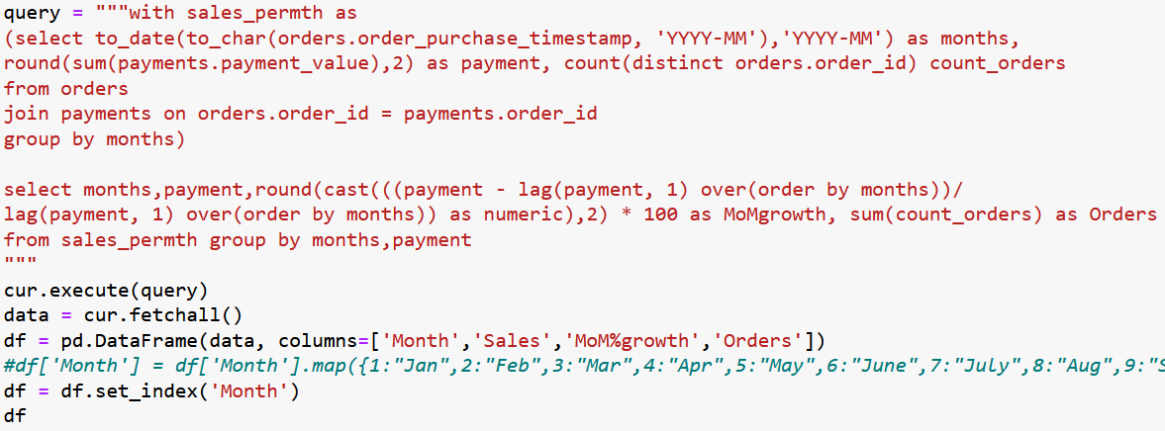
Question 3 : Calculate the month-over-month growth rate of total sales.

Slide 14
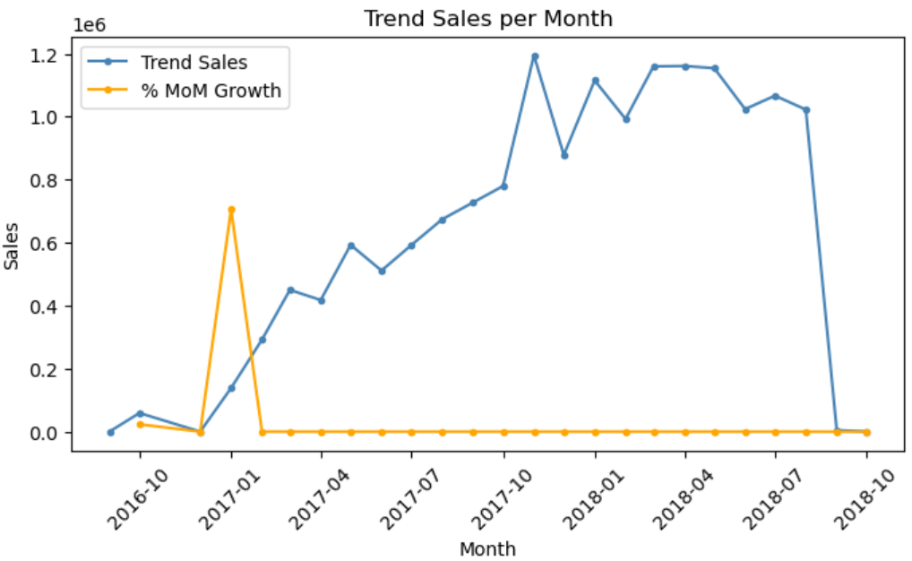
Question 3

Slide 15
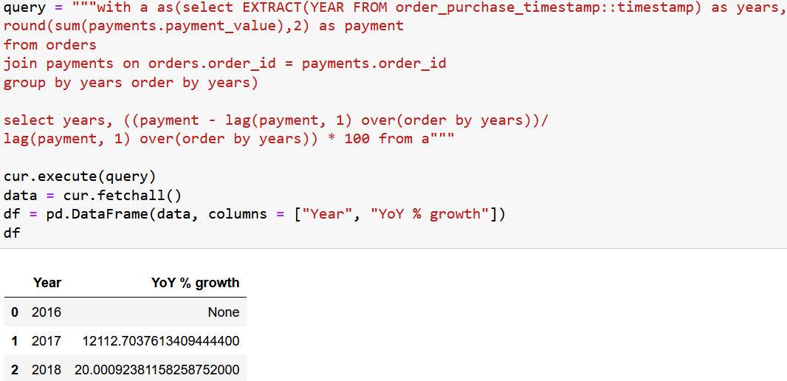
Question 4 : Calculate the year-over-year growth rate of total sales.

Slide 16
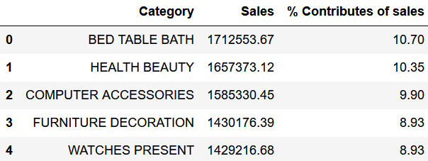
Question 5 : Top 5 of category products which have the highest percentage contributes of sales.

Slide 17
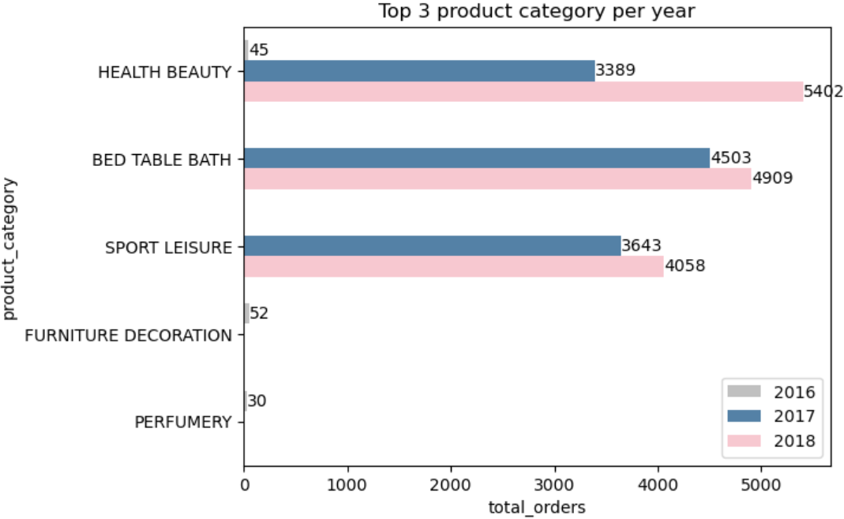
Question 6 : Find top 3 product cotegory which contribute numerous orders per year.

Slide 18
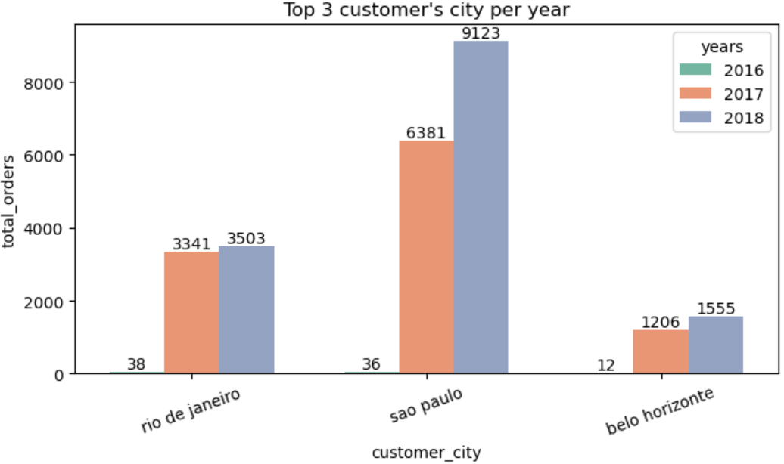
Question 7 : Find top 3 customer's city where contribute numerous orders per year.

Slide 19
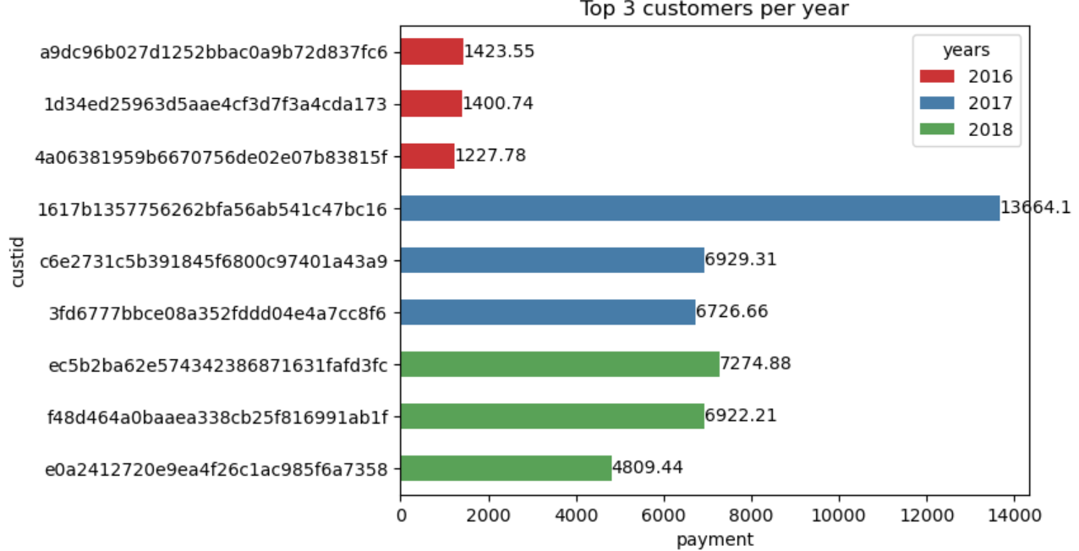
Question 8 : Identify the top 3 customers who spent the most money in each year.

Slide 20
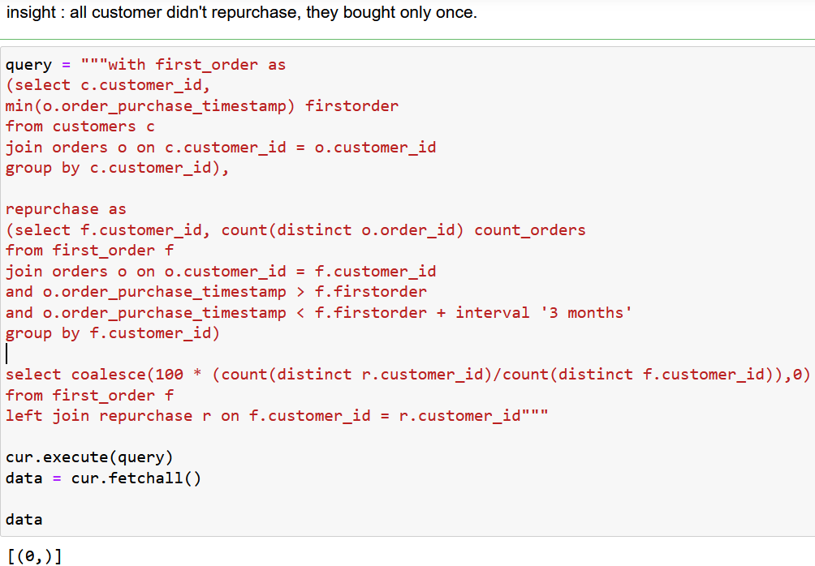
Question 9 : Defined as the percentage of customers who make another purchase within 3 months of their first purchase.

Slide 21
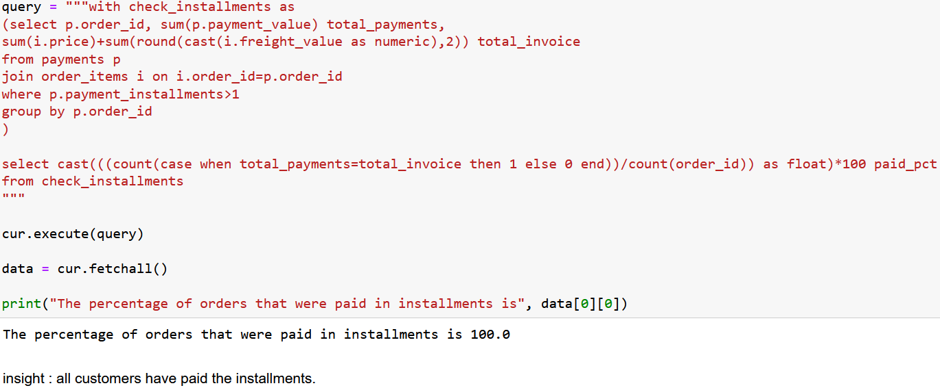
Question 10 : Calculate the percentage of orders that were paid in installments.

Slide 22
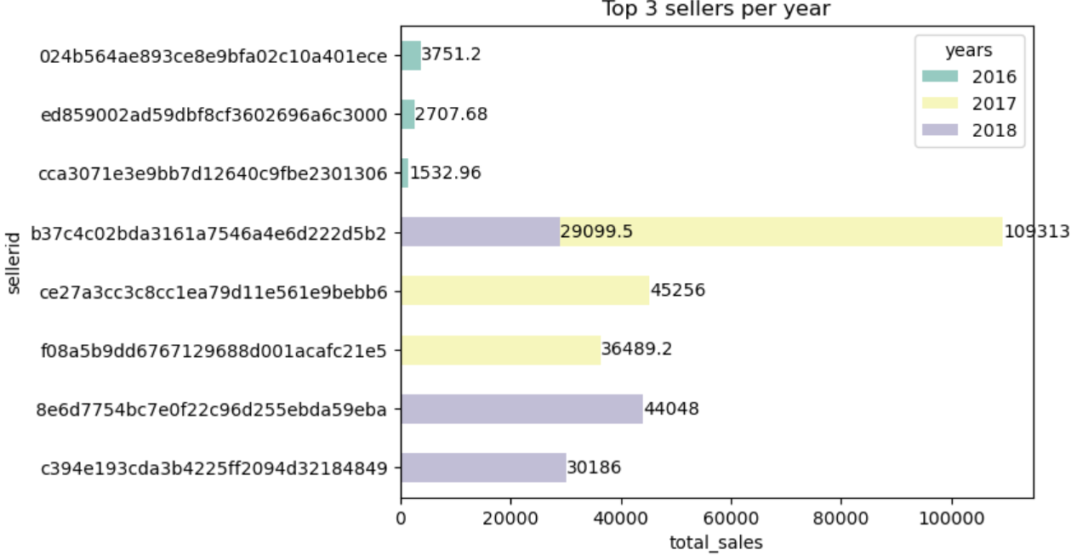
Question 11 : Top 3 sellers by total sales per year.

Slide 23


Connect with me :
endahen12@gmail.com
Thank you
https://www.linkedin.com/in/endahrakhmawati/
Thank you

